Slide 1


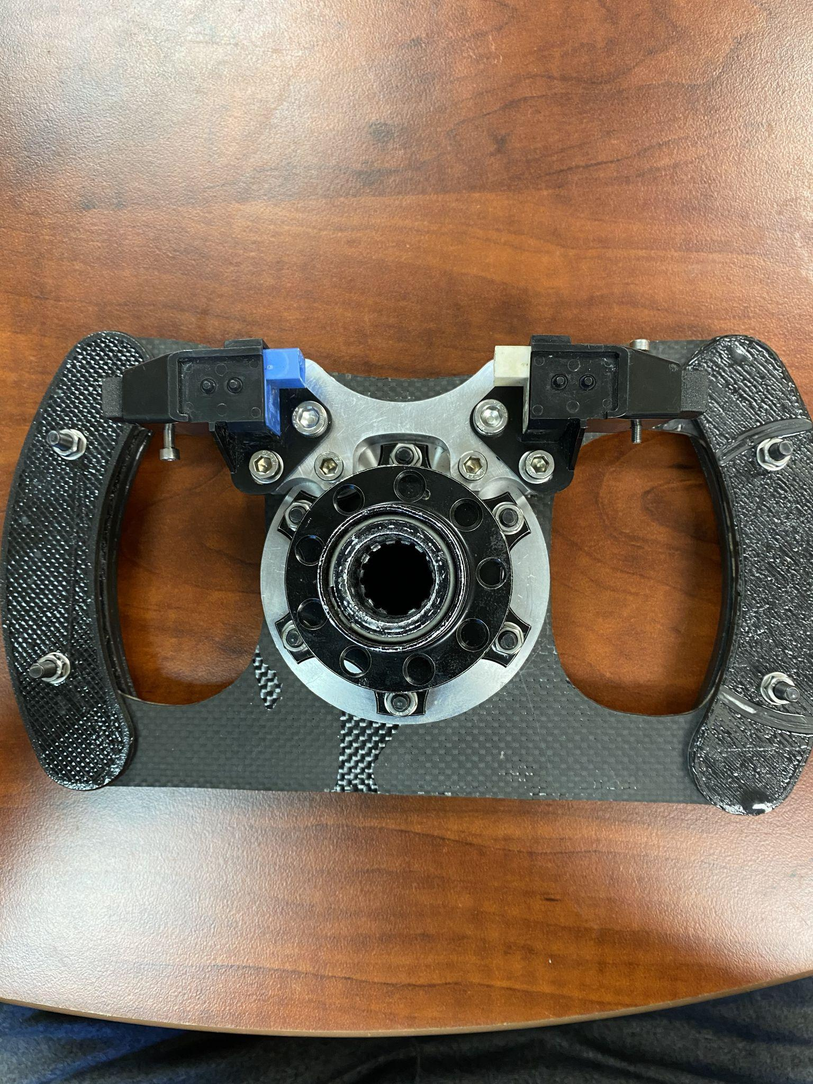
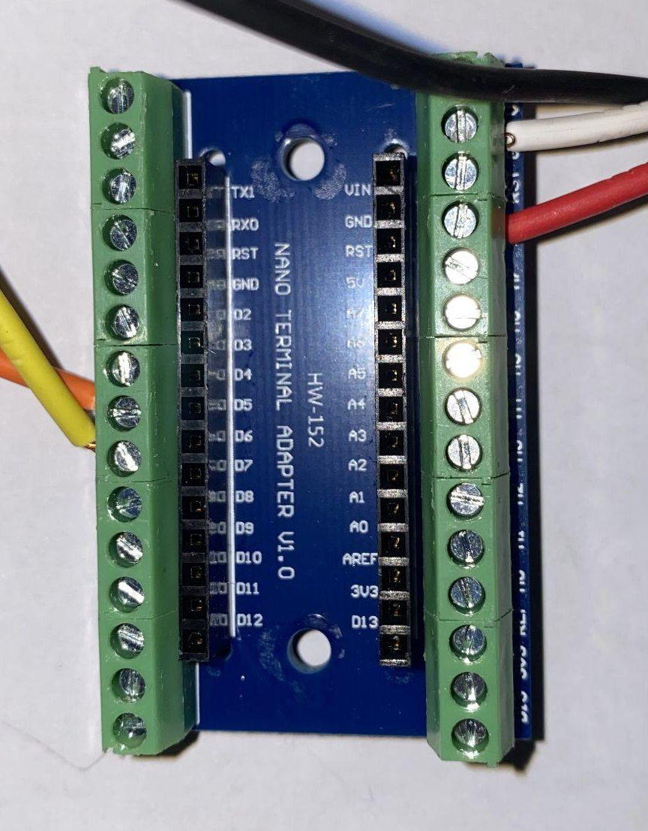
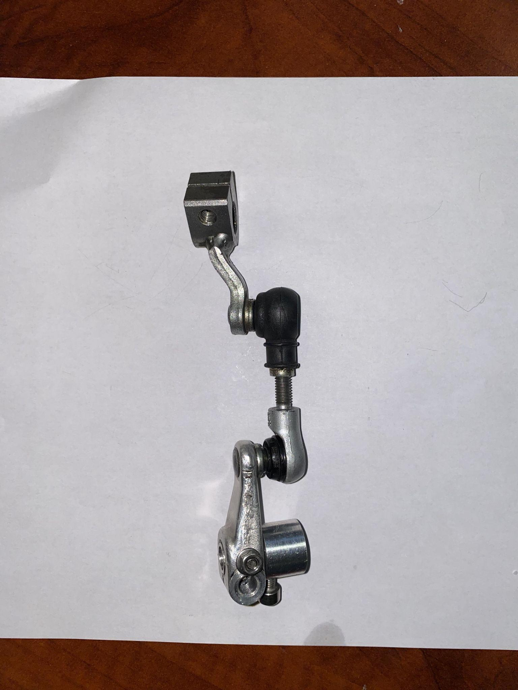
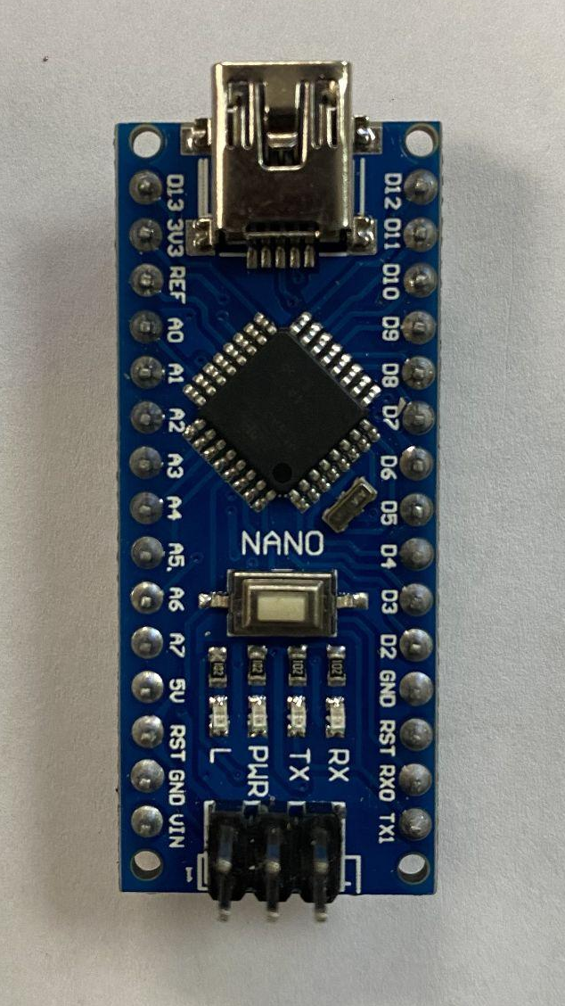
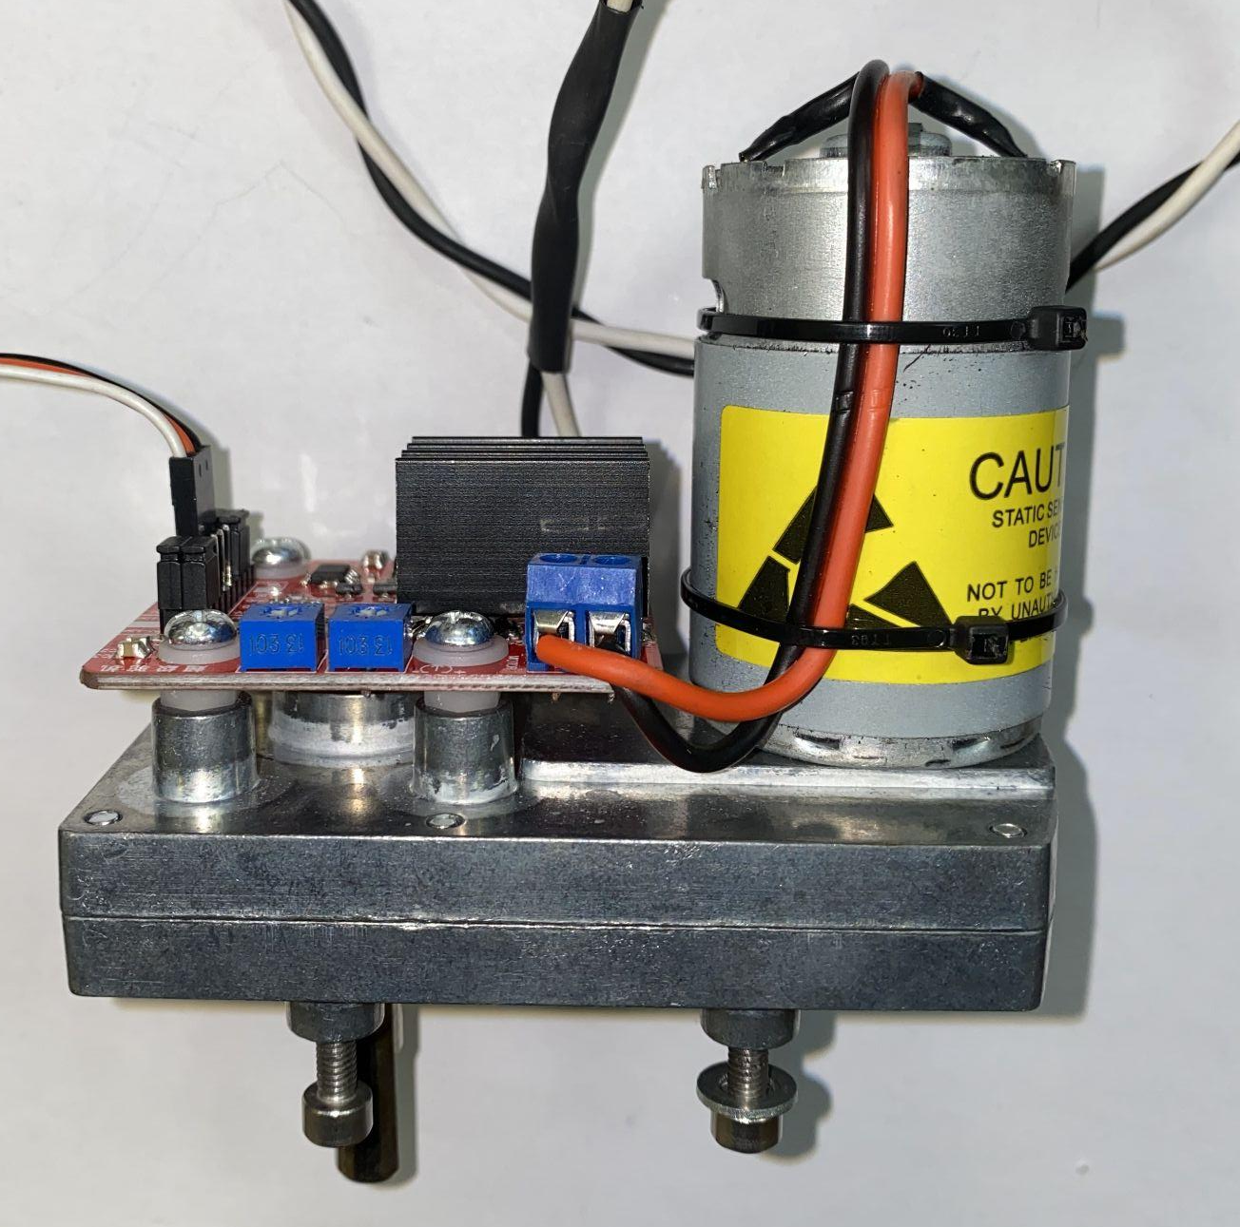
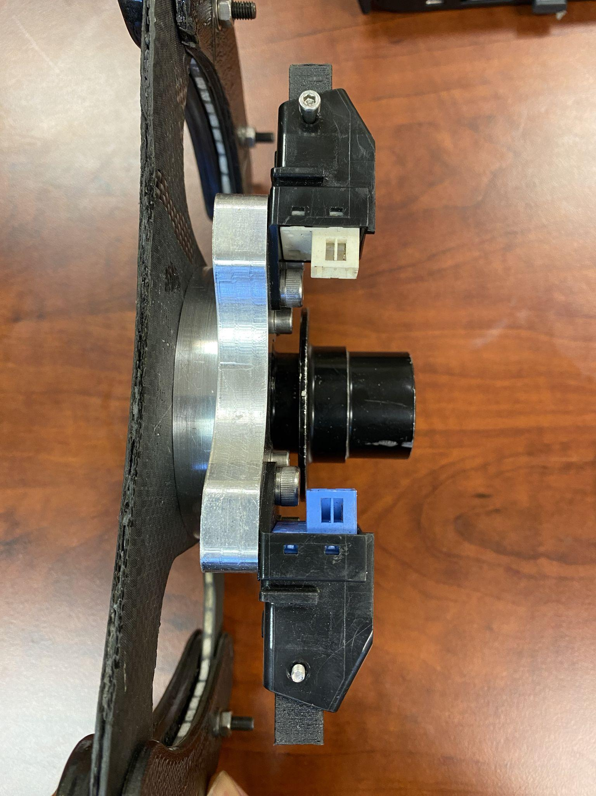
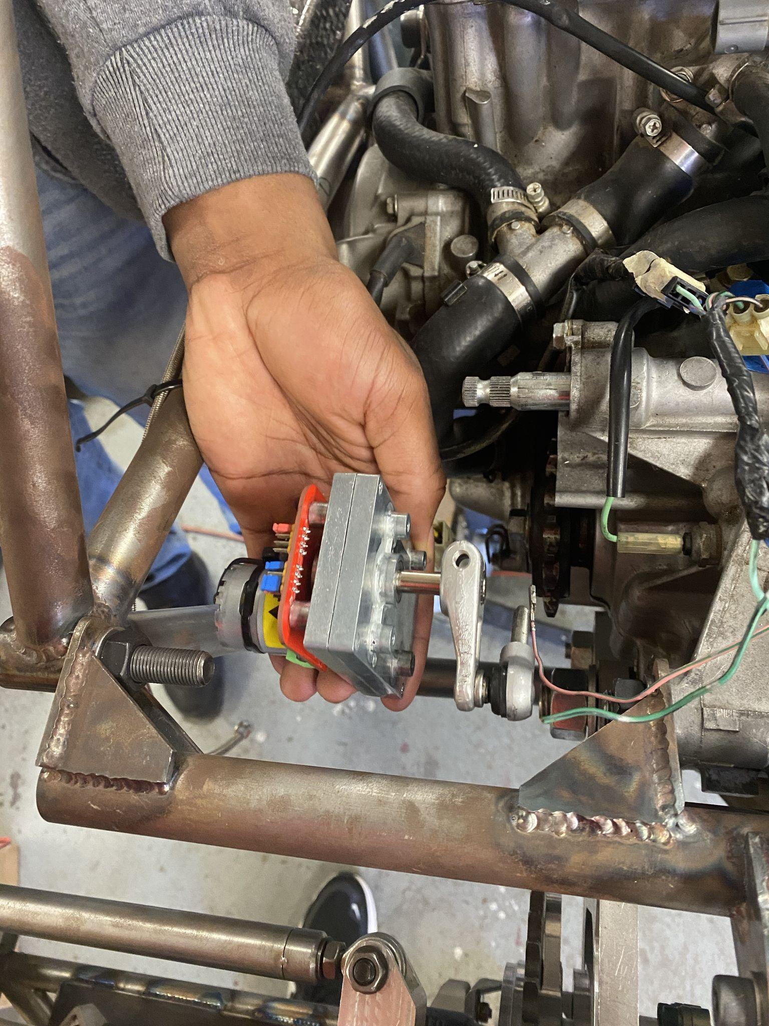
Design of an Electronic Gear Shifting Assembly Using Paddle Shifters
Jibrail Muhammad Jr, Dandrell E. Johnson II, Dr. Wing Chan
Alabama Agricultural & Mechanical University
ABSTRACT
MATERIALS
DISCUSSION
Traditional stick manual transmission shifting systems have proven to decrease Formula SAE drivers' controllability and acceleration time during cornering and braking. The deficiency yields grounds for a limited driver reaction time which can produce unwanted engine revs that require increased fuel consumption and potentially damage the transmission. Once a shift is needed, the driver is limited to completing this task with one hand on the steering wheel. The research examined how an electronic gear-shifting system can improve the response time required to initiate and complete a gear change in the vehicle transmission system. An observed elapsed time to complete a horizontal manual gear shift occurred between 1- 2 seconds; however, an ideal gear shift time to maximize engine efficiency is completed in less than 625 milliseconds. A modified Honda Acura paddle shifter is implemented onto the Formula SAE steering wheel to decrease the shift response time. Implementing the electronic gear shifter proved to be 33 times more efficient by decreasing the response time from 1 second to 30 milliseconds. Decreasing gear-shifting response timing yielded better engine revs that created ideal RPM levels. Achieving efficient and quick gear shifts maximize the ability to maintain the vehicle's momentum and decrease damaging engine components.
Arduino Nano (below): Microcontroller board used to process inputs and distribute the programmed outputs
Overall, paddle shifter systems can enhance the driving experience for those who enjoy more control over their vehicles. However, it is important for drivers to understand how to use the system correctly and safely, as incorrect use can cause damage to the vehicle or compromise safety. The fabricated prototype achieved the target functionality set by the team. The Arduino Nano received and generated a mechanical shift in the desired time as determined by the team. The prototype provided ample opportunities to improve and expand upon Design Failure Mode and Analysis skills. Future suggestions for system improvements should aim to improve the paddle response sensitivity. It was discovered that the left paddle response time was not as reliable as the team wanted. During initial testing, the paddle responded to 4 out of 10 shift attempts. It can be assumed the binary code used by the Arduino may be the source of error or improper installation of the paddle covers. Engineers would recommend a further root cause analysis to be conducted for system improvements and maintenance.
Servo Motor (below): a device that can rotate or push parts of a machine with precision
Honda Acura Paddle Shifters (above): Buttons located behind the steering wheel that allows the driver to manually shift into gears
Arduino Nano Terminal Adapter (above): Allows for maintenance of the microcontroller board without detaching external wiring of the prototype
Gear shifting Rod (above): System of metal rods that connect to the transmission shifter to produce a change of gears
INTRODUCTION
To maximize competition performance, FSAE vehicles need efficient gear-shifting systems. Manual stick gear shifting in a Formula Style vehicle creates unideal racing conditions threatening the engine and, most importantly, the driver's safety. Ineffective gear shifting leads to unwanted engine revs that decrease lap times due to deviation in acceleration points. Manual stick gear shifting requires the driver to constantly remove their hand from the steering wheel, significantly increasing the likelihood of driver fatigue and crashing. The team decided to utilize electrical energy to create a mechanical shift. An electronic paddle shifter system will be analyzed to determine if the gear-shifting system goals are achieved. An electronic paddle shifter would allow the driver to initiate the shifting of gears without removing their hand from the steering wheel. This assembly helps improve race performance by increasing the driver's ability to focus on the overall control of the vehicle while cornering or braking.
RESULTS
Order of System Processes | Responsive Action
Process #1 | The driver applies a force to the left or right 3D printed paddle covers
Process #2 | The Honda Acura shifter system generates an electromagnetic current/signal
Process #3 | Arduino Nano receives the input(signal) to generate 2 outputs. One to the gear indicator of the cockpit and one to the servo motor.
Process #4 | The servo motor is prompted to move the gear shifting rod in a bi-directional manner depending on the given input
Process #5 | The vehicle transmission shifter is actuated and creates a shift in gears
ACKNOWLEDGEMENTS
Alabama A&M University
Department of Physics
Mentor name(s) go here
Dr. Wing Chan
Cyntonia Carrol
This material is based upon work supported by the National Science Foundation Grant
Table showing the average cost of paddle system designed by the team. Currently, Formula style vehicle paddle attachments for the steering wheel alone can exceed $700.
Item | Quantity | Total cost
Honda Acura Shifters Sensor | 1 | $100
3D Printed Shifter Covers/Paddles | 2 | $60
Paddle shifters mount | 1 | $40
Arduino Nano | 1 | $30
Arduino Nano Terminal Adapter | 1 | $20
Servo Motor | 1 | $100
Gear shifter linkage | 1 | $40
 | Estimated Total | $390
REFERENCES
Driving Withthepaddleshifters - Honda. http://techinfo.honda.com/rjanisis/pubs/om/TK0707/TK0707O00299A.PDF.
“Nano Screw Terminal Adapters.” Mouser, 19 Sept. 2022, https://www.mouser.com/new/arduino/arduino-nano-screw-terminal-adapters
Sabhadiya, Jignesh. “What Is Servo Motor?- Definition, Working and Types.” Engineering Choice, 3 Apr. 2023, https://www.engineeringchoice.com/what-is-servo-motor/.
System Parameters
Forces Required for Shifting | Vehicle at rest: 10 foot pound Vehicle in motion: 5.5 foot pound
Servo Motor Angles for Shifting | Upshift: 180 degrees Downshift: 0 degrees Neutral: 120 degrees Rest: 90 degrees
jjkjkkjknkjnknknknknknknknknknknknknk
Notes:
‹#›

